Slide 1
Instructions for Entering or Editing Network Settings in SmartPAC PRO

Slide 2
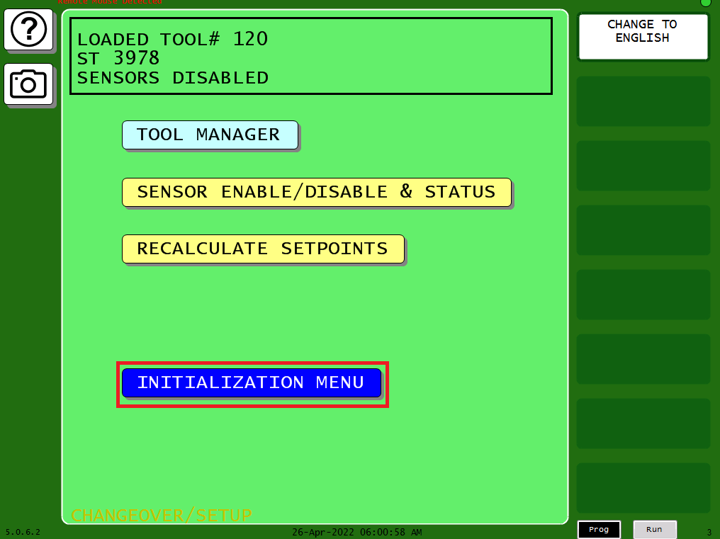
Navigate to the Program Menu and Select “INITIALIZATION MENU”

Slide 3
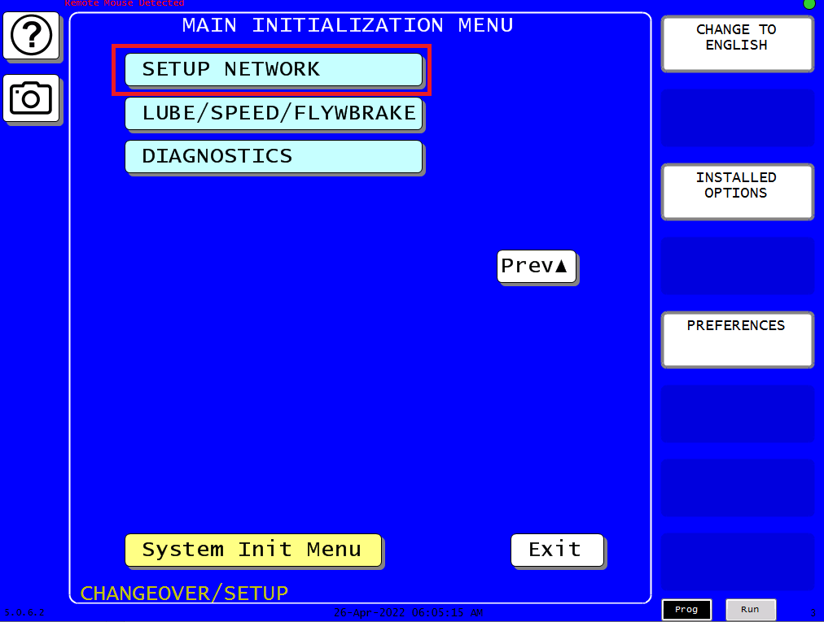
Selecting the “Next” button, navigate to the “SETUP NETWORK” menu.

Slide 4
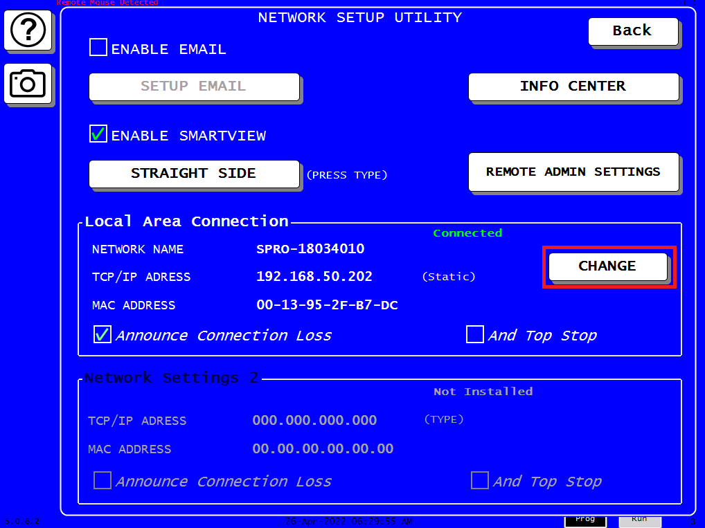
Select the “CHANGE” button in the “Local Area Connection” portion of the menu.

Slide 5
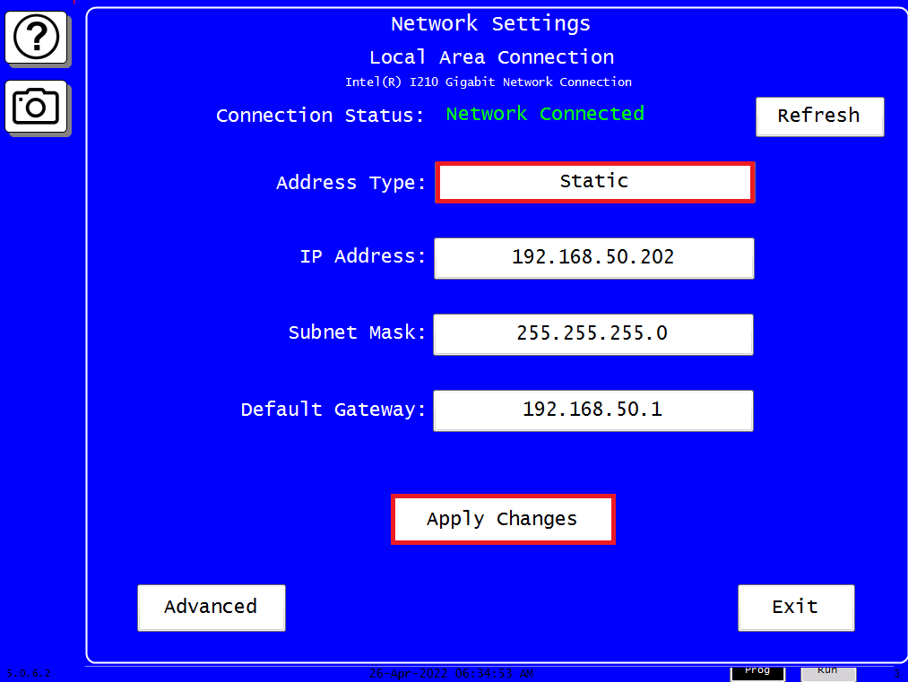
Select between “Static” or “DHCP” for the “Address Type” (note for ShopFloorConnect , “Static” is recommended or if DHCP is selected the obtained IP address must be reserved). To enter IP address, Subnet Mask and Default Gateway settings, click on each field for the entry screen. Remember to select “Apply Changes” when done. The PRO will restart itself.

Slide 6
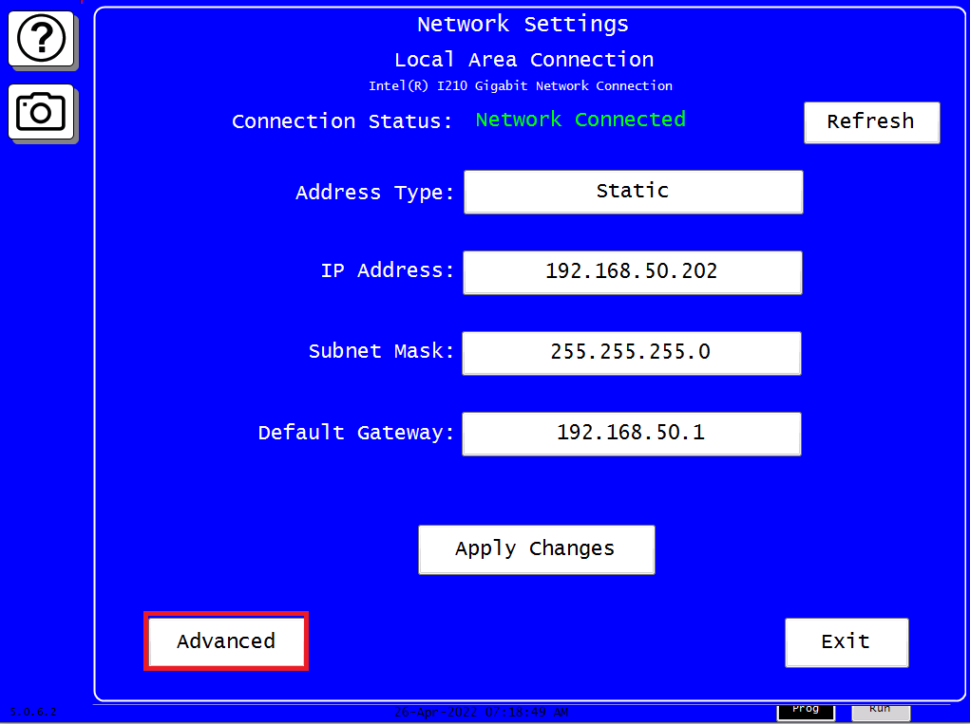
Select the “Advanced” button to view or enter the following settings: “Computer Name”, “Preferred DNS”, “On Screen Keyboard” and “Control Panel” Note, DNS settings are optional unless specified by your IT department.

Slide 7
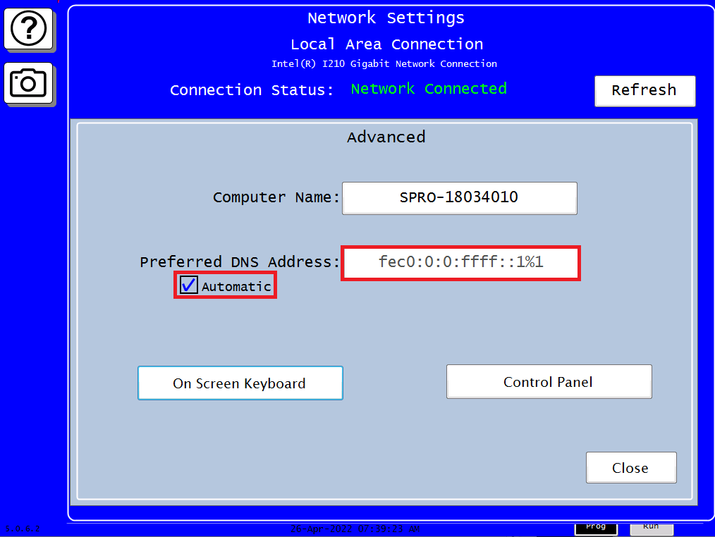
To obtain a “Preferred DNS Address” automatically, leave the “Automatic” check box checked on. To manually enter a “Preferred DNS Address”, uncheck the “Automatic” check box and select the field to open the entry menu. Note: Do not change the “Computer Name” without contacting Wintriss Technical Support. Typically, it is never necessary to change the “Computer Name”.

Slide 8
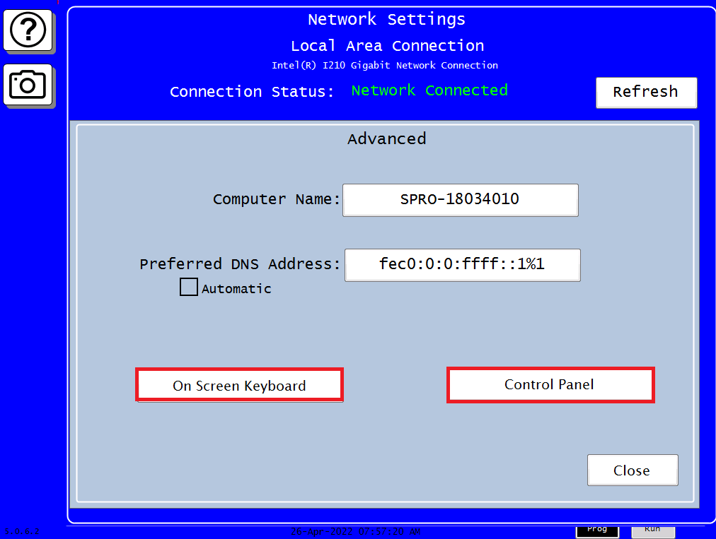
Plug a USB mouse into the PRO’s USB connector on the front Panel. Select the “On Screen Keyboard” button, then select “Control Panel” and navigate as follows, “Network and Internet” > “Network and Sharing”> “Change Adapter settings” >”Local Area Connection”>mouse right click >Properties>Internet Protocol Version 4(TCP/IPv4)>Properties. Then use “On Screen Keyboard: to enter DNS settings. When done, click OK > Close>click the red upper right X’s on each menu to close out the remember to click the “Apply Changes” button on the “Network Settings” menu

Slide 9
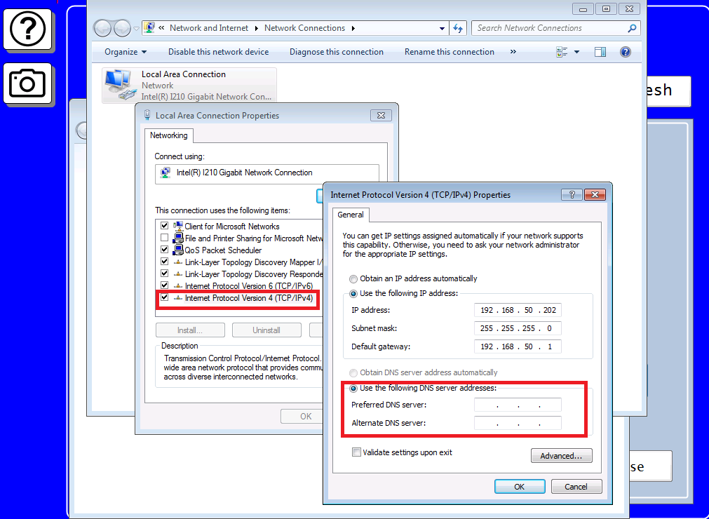
“Control Panel Local Area Connection” menus

